Slide 1

Energy system modelling using OSeMOSYS
LECTURE 11
MODELLING OF THE RESIDENTIAL AND COMMERCIAL AND PUBLIC SERVICES SECTORS

Slide 2
Learning Outcomes
By the end of this lecture, you will be able to:
ILO1: Learn about the energy consumption in the residential sector
ILO2: Learn about the energy consumption in the commercial and public services sector
ILO3: Understand how to model end-use technologies in the residential and commercial and public services sectors using OSeMOSYS
ILO4: Perform basic calculations in the estimation of parameters for modelling end-use technologies
2

Slide 3




11.1 Residential sector
11.1.1 Introduction
The residential sector encompasses all energy consumption within households, including single-family homes, apartments, and other living spaces.
Source: Statista (2024) - Link
3
Notes:
The residential sector encompasses all energy consumption within households, including single-family homes, apartments, and other living spaces. This sector plays a crucial role in global energy systems, accounting for almost one fifth of total energy demand. Energy use in this sector is highly diverse and influenced by factors such as geography, climate, income levels, and urbanization. In many regions, the residential sector represents a critical area for addressing energy access, improving efficiency, and reducing emissions, particularly in the transition to cleaner energy systems.
Energy demands in the residential sector are driven by essential activities, including space heating, water heating, cooking, lighting, and the operation of household appliances. These demands vary considerably across regions, with heating dominating in colder climates and cooling becoming increasingly significant in warmer areas. The sector’s energy consumption is also shaped by technological advancements, lifestyle changes, and government policies promoting efficiency and clean energy adoption. Disclaimer: This lecture is not a resource to enable one to go from an energy balance to modelling the sector but rather provides an overview of the sector.

Slide 4
11.1 Residential sector
11.1.2 Urban and rural areas
Urban and rural households have distinct energy needs and challenges, requiring tailored solutions to achieve sustainable and inclusive energy transitions.
Source: UPME (2022)
4
Notes:
Modelling the residential sector often requires dividing it into urban and rural areas to capture key differences in energy demand patterns, technology access, and resource availability. Urban households generally exhibit higher energy consumption due to better access to electricity, advanced appliances, and modern heating and cooling systems. In contrast, rural areas often rely more on traditional fuels, such as biomass, for cooking and heating, particularly in developing regions. These distinctions are crucial for understanding energy use and designing effective policies, as urbanization trends typically lead to shifts in energy demand profiles.
In the figure on the slide, we see energy consumption in the urban and rural subsectors for Colombia in 2021. Urban areas demonstrate significant access to electricity and natural gas, whereas biomass remains the dominant fuel in rural areas.
This subdivision is highly dependent on data availability and enables models like OSeMOSYS to account for the unique challenges and opportunities in each area. Urban settings often present opportunities for energy efficiency measures, electrification, and district heating systems. Meanwhile, rural areas may benefit from solutions that improve access to clean cooking technologies and decentralized energy systems, such as solar home systems.
By capturing these variations, energy models can deliver more accurate projections and support tailored strategies to meet energy needs and achieve sustainability goals across both urban and rural populations.

Slide 5



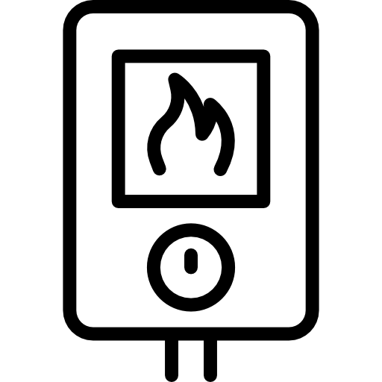
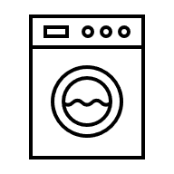




11.1 Residential sector
11.1.3 Energy demands in the residential sector
The most common energy demands modelled are:
Space heating
Air conditioning
Cooking
Water heating
Other electrical appliances
Lighting
5
Notes:
The residential sector’s energy demand is driven by essential end-uses that support daily living, with the most significant being space heating, water heating, cooking, lighting, and the operation of household appliances. Space heating dominates in colder climates, often accounting for the largest share of energy use, while cooling demands are rapidly growing in warmer regions due to climate change and urbanization. Cooking remains a vital energy use, particularly in regions where traditional biomass is still widely used. Lighting and appliances, though smaller in share, are growing contributors to residential energy consumption, driven by increasing electrification, rising incomes, and expanded appliance ownership.
Energy demands in the residential sector vary significantly across regions and income levels. In high-income countries, the focus is on improving energy efficiency and transitioning to renewable energy for heating and cooling. In contrast, in low- and middle-income regions, the priority is often expanding access to clean energy for cooking and electrifying homes. Emerging trends such as smart home technologies, energy-efficient appliances, and renewable energy integration are reshaping residential energy use globally. Understanding these diverse demands and trends is essential for designing effective energy policies and achieving sustainability targets. Most of these demands would be ‘Specified Annual Demands’ because they varying depending on the time of year. For example, you will see more space heating in the colder seasons and more air conditioning in the warmer ones. Similarly, you might see more lighting use in the residential sector during the mornings and evenings but less in the daytime. Due to this the ‘Specified Demand Profile’ for each country and service is very important to consider. It is important to note that both residential and commercial sectors we model explicit services where fuel switching is an option like cooking, where you could have gas stoves, electric stoves and so on. We wouldn’t really model demands like ‘Vacuum cleaners demand’ explicitly because there is no fuel switching choice, vacuum cleaners simply use electricity so all appliances like this are grouped under ‘Other Electricity’ or ‘Other Electrical Appliances’.

Slide 6
11.1 Residential sector
11.1.4 Key drivers and challenges in residential energy use
Drivers
Population growth
Urbanization
Challenges
Reliance on traditional biomass
Decarbonization of space heating
Technological advancement
Behavioral and cultural barriers
Income level
Increasing demand for cooling
6
Notes:
Several factors drive energy demand in the residential sector, including population growth, urbanization, income levels, and technological advancements. As populations grow and urbanize, the number of households and their energy needs increase, particularly in rapidly developing regions. Rising incomes often lead to greater ownership of energy-consuming appliances and improved access to heating, cooling, and other services, further driving energy demand. Technological innovation is also a critical driver, enabling energy efficiency improvements and the adoption of renewable energy systems like solar water heaters and heat pumps, which can help decouple energy consumption from emissions growth.
Despite these advancements, significant challenges remain in transitioning the residential sector to sustainable energy use. In many low- and middle-income regions, reliance on traditional biomass for cooking and heating persists, contributing to health issues and environmental degradation. Additionally, the decarbonization of space heating and cooling remains complex, particularly in areas with aging infrastructure or limited access to clean energy sources. Addressing the rising demand for cooling due to climate change and urbanization is another pressing challenge. Furthermore, behavioral and cultural barriers often hinder the adoption of energy-efficient technologies, as consumers may prioritize upfront costs over long-term savings or lack awareness about cleaner alternatives. Overcoming these barriers requires coordinated efforts, including policy incentives, technological innovation, and public awareness campaigns to promote energy efficiency and renewable energy adoption. The list of drivers and challenges is not exhaustive.

Slide 7
Lecture 11.1 References
UPME. (2022). Balance Energético Colombiano 2021. https://www1.upme.gov.co/DemandayEficiencia/Paginas/BECO.aspx
Plazas-Niño, F. A., Yeganyan, R., Cannone, C., Howells, M., & Quirós-Tortós, J. (2023). Informing sustainable energy policy in developing countries: An assessment of decarbonization pathways in Colombia using open energy system optimization modelling. Energy Strategy Reviews, 50, 101226. https://doi.org/10.1016/j.esr.2023.101226
7

Slide 8

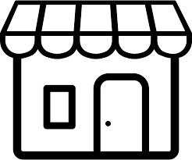

11.2 Commercial and public services sector
The commercial and public services sector encompasses energy use in buildings and facilities dedicated to commerce, education, healthcare, government, and other non-residential activities.
11.2.1 Introduction
Source: Statista (2024) - Link
8
Notes:
The commercial and public services sector encompasses energy use in buildings and facilities dedicated to commerce, education, healthcare, government, and other non-residential activities. This sector accounts for almost one tenth of total energy demand. This sector is diverse, covering a wide range of energy demands, including space heating and cooling, lighting, water heating, and the operation of equipment such as computers and industrial-grade machinery. In many regions, the sector accounts for a significant share of electricity consumption due to its reliance on lighting, cooling, and electronic devices, particularly in densely populated urban areas. As economies grow and service-based industries expand, energy use in this sector is expected to rise.
The commercial and public services sector is characterized by its diverse building types and functions, ranging from small retail shops to large hospitals, schools, and office complexes. Energy demand patterns in this sector are highly variable, influenced by factors such as building size, occupancy, operational hours, and the intensity of energy services required. For example, hospitals and data centers have constant, high energy demands, while schools and offices may have more predictable and time-limited usage. This sector is crucial not only for its economic contributions but also for its role in supporting social infrastructure, such as education, healthcare, and governance. Its energy use also offers significant opportunities for efficiency improvements and renewable energy integration, making it a key focus area for achieving sustainability goals.

Slide 9
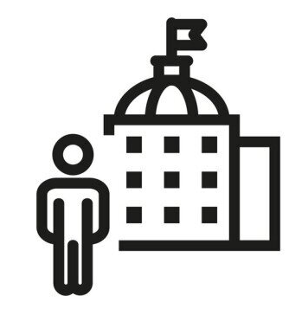




11.2 Commercial and public services sector
11.2.2 Subsectors
Disaggregation into subsectors is typically based on the primary activity that defines the energy demand profile.
Commercial and tourism
Public services
Finance and business
Other
services
9
Notes:
If data is available, disaggregating the commercial and public services sector involves dividing it into subsectors based on the primary activities and energy demands of different building types and facilities. Key criteria for this disaggregation include building function (e.g., retail, healthcare, education), operational characteristics (e.g., hours of operation, energy intensity), and energy end-uses (e.g., heating, cooling, lighting). For instance, retail buildings may be further split into large shopping malls and small shops due to differences in size and energy consumption patterns. Similarly, public services can be categorized into government buildings, schools, and hospitals, each with distinct energy demands and usage profiles. This structured approach helps capture the diversity within the sector and ensures that models accurately reflect real-world energy consumption.
The process of disaggregation often starts with data collection and classification based on national energy surveys, building codes, or economic activity data. Common frameworks, such as the International Energy Agency (IEA) or IPCC guidelines, provide standardized categories for subsector classification. Advanced approaches may also incorporate regional or climatic variations, distinguishing between air-conditioned offices in hot climates and naturally ventilated buildings in temperate zones. For energy modeling, each subsector is assigned specific energy demand profiles, technologies, and efficiency parameters, enabling precise scenario analysis and policy evaluation. This level of detail is crucial for identifying targeted interventions, such as retrofitting energy-intensive hospitals or improving efficiency in underperforming school buildings.

Slide 10

11.2 Commercial and public services sector
11.2.3 Energy demands in the commercial-public services sector
The most common energy demands modelled are:
Space heating
Motive power
Other thermal uses
Air conditioning
Other electrical appliances
Lighting
10
Notes:
The commercial and public services sector exhibits a very similar set of final energy demands to the residential sector. Space heating and air conditioning are among the most significant energy uses, particularly in regions with extreme temperatures, where maintaining indoor comfort is a priority. Thermal energy is also vital for specific applications, such as water heating in hotels, steam generation in hospitals, and cooking in restaurants. Motive power is another key demand in facilities such as elevators, escalators, and industrial-grade equipment used in some commercial operations. These varied demands result in a complex energy profile that requires tailored solutions for each application.
Electricity is a dominant energy source in this sector, powering lighting, air conditioning, and electrical appliances, such as computers, servers, and medical equipment. Lighting alone represents a significant share of electricity use, especially in offices, retail spaces, and educational facilities. Other fuels, such as natural gas or biomass, play an essential role in thermal applications like space heating or cooking. The demand for cooling and air conditioning is rising rapidly in response to urbanization, economic growth, and climate change, increasing electricity consumption in warmer regions. Accurately modelling these demands is crucial to identifying opportunities for energy efficiency, electrification, and the integration of renewable energy solutions. Most of these demands would be ‘Specified Annual Demands’ since they are likely to vary based on the time of year it is. For example, you are likely to see more space heating in the colder seasons and more air conditioning in the warmer seasons. Similarly, commercial services are likely to use lighting during the day and less during the evenings depending on the service. Consequently, it is important to determined the ‘Specified Demand Profile’ of the services in the commercial and public services sector.

Slide 11
11.2 Commercial and public services sector
11.2.4 Key drivers and challenges in commercial-public services energy use
Drivers
Economic growth
Urbanization
Challenges
High variability in services
Aging infrastructure
Population growth
Outdated building design policy
Digitalization
Increasing demand for cooling
11
Notes:
Several factors drive energy demand in the commercial and public services sector. Economic growth and urbanization are among the most significant drivers, leading to the construction of new buildings and facilities to support expanding service-based economies. The proliferation of digital technologies, such as data centers and office equipment, further increases electricity consumption. Additionally, population growth and rising expectations for public services, such as healthcare and education, contribute to increasing energy demand in this sector. These drivers highlight the growing importance of addressing energy consumption patterns in commercial and public buildings.
Decarbonizing the commercial and public services sector faces several challenges. One major obstacle is the high variability in energy use across subsectors, which makes it difficult to implement one-size-fits-all solutions. Aging infrastructure and outdated building designs also hinder efforts to improve energy efficiency. Furthermore, meeting the rising demand for cooling due to global warming poses significant energy and environmental challenges. Addressing these barriers requires a combination of policy measures, investment in retrofitting existing buildings, and the adoption of innovative technologies, such as smart energy management systems and renewable energy integration. This list is not exhaustive.

Slide 12
Lecture 11.2 References
Plazas-Niño, F. A., Yeganyan, R., Cannone, C., Howells, M., & Quirós-Tortós, J. (2023). Informing sustainable energy policy in developing countries: An assessment of decarbonization pathways in Colombia using open energy system optimization modelling. Energy Strategy Reviews, 50, 101226. https://doi.org/10.1016/j.esr.2023.101226
12
12

Slide 13
11.3 Modelling of residential and commercial-public services sector using OSeMOSYS
11.3.1 Technologies in the reference energy system
Cooking demand
Biomass
BIO
RESCKN
Biomass stove
DEMRESCKNBIO
Water heating demand
Natural gas
NGS
RESWHE
Natural gas water heater
DEMRESWHENGS
Refrigeration demand
Electricity
ELC003
COMREF
Low-efficiency refrigerator
DEMCOMREFLOW
13
Notes:
Similar to power plants, end-use technologies are represented as boxes in the reference energy systems. The input commodities can be either secondary energy carriers (e.g., LPG, electricity) or primary energy carriers (e.g., biomass, natural gas), depending on the technology, while the output commodity corresponds to the final energy demand.
The examples shown on the slide illustrate three final energy demands previously described: cooking, water heating, and refrigeration. Note that refrigeration is an additional split within electrical appliances for cases where a more detailed analysis is needed.
Additional technological alternatives for meeting these final energy demands can be included, as we will explore in the next slide, to analyze future energy transition pathways. If you need a refresher on the naming conventions, refer to the material from Lecture 3.

Slide 14
11.3 Modelling of residential and commercial-public services sector using OSeMOSYS
11.3.2 Technological choices
Fuel switching
Efficiency improvement
Cooking demand
Refrigeration demand
Biomass
Electricity
Biomass stove
Low-efficiency refrigerator
Cooking demand
Refrigeration demand
LPG
Electricity
LPG stove
Medium-efficiency refrigerator
Cooking demand
Refrigeration demand
Electricity
Electricity
High-efficiency refrigerator
Electrical stove
14
Notes:
The strategy for modeling final energy demands focuses on analyzing potential energy transition pathways. These future optimal pathways are determined by a mix of different technological choices. The range of technological options is defined by the modeler based on system-specific conditions, such as resource availability, affordability, and stated policies.
For example, in a country without natural gas reserves or infrastructure, it would be unrealistic to include natural gas stoves or water heaters as options—unless a neighboring country is a significant natural gas exporter with plans to support pipeline deployment and trade. This highlights why the selection of technologies to model must be highly case-specific.
In general, three approaches can be used for modeling technological choices: fuel switching, efficiency improvements, or a combination of both.
In the first example (on the left), the same cooking demand can be met by different fuels: biomass, LPG, or electricity. This allows for an analysis of potential fuel switching between different energy carriers.
In the second example (on the right), the input fuel (electricity) remains the same, but the technologies differ in their efficiencies for meeting refrigeration demand. This enables an assessment of the impacts of efficiency improvements.

Slide 15
11.3 Modelling of residential and commercial-public services sector using OSeMOSYS
11.3.3 Defining end-use technologies in OSeMOSYS
Key parameters for defining end-use technologies in the residential and commercial-public services sector:
Output Activity Ratio
Input Activity Ratio
Capital Cost
Fixed Cost
Residual Capacity
Operational Life
15
Notes:
For end-use technologies in the residential and commercial-public services sectors, a few key parameters are sufficient to provide a good characterization.
Output and Input Activity Ratios: These are used to define the efficiency of the technology, as studied previously. Energy efficiency is particularly important in the buildings sector. For explicitly represented technologies (e.g. different heating boilers) we change the efficiency directly over time but for ‘all other electrical appliances’ we would just reduce the demand exogenously rather than tweaking the input activity ratio if we are assuming some efficiency gains.
Capital Cost: This is critical as it reflects the commercial price of appliances or technologies. Capital cost is particularly significant from a behavioral perspective in these sectors, as people often prioritize price over quality, efficiency, durability, or other features.
Fixed Cost: Applicable to technologies requiring periodic maintenance.
Residual Capacity: Represents the installed capacity of each technology, typically based on the number of devices or appliances in these sectors.
Operational Life: Denotes the lifespan of each technology, usually provided by the manufacturer.
In the next section, we will explore some basic calculations to estimate these parameters when data is unavailable.

Slide 16
11.3 Modelling of residential and commercial-public services sector using OSeMOSYS
11.3.4 Example of end-use technologies in OSeMOSYS
Cooking demand
Output Activity Ratio: 1
Input Activity Ratio: 2.44
Capital Cost: 173 USD/kW
Fixed Cost: 0 USD/kW
Residual Capacity: 725 MW
Operational Life: 19 years
Natural gas
Natural gas stove
NGS
RESCKN
DEMRESCKNNGS
If the efficiency is 41% and the output activity ratio (RESCKN) is 1:
Input Activity Ratio = 1/0.41 = 2.44 (NGS)
16
Notes:
This slide presents example data for a natural gas stove, sourced from a 2023 paper that used OSeMOSYS to model the Colombian energy system.
The capital cost is 175 USD per kW, while there is no fixed cost, as it assumes no need for periodic maintenance or annual taxes for a conventional stove. The residual capacity is provided in MW; however, we’ll later see how this value directly correlates to the total number of stoves, which is a more intuitive measure. The operational life is set at 19 years, which is relatively high for this type of technology but reflects the reality in Colombia, where devices are used beyond the standard manufacturer lifespan.
This slide also includes an example calculation for the input activity ratio. The output fuel is cooking demand, and the output activity ratio is set to a default value of 1, as in previous examples. The input activity ratio can be calculated by dividing 1 by the efficiency. In this case, dividing 1 by 0.41 yields an input activity ratio of approximately 2.44. This value would be assigned to natural gas, as it is the input fuel for a natural gas stove

Slide 17
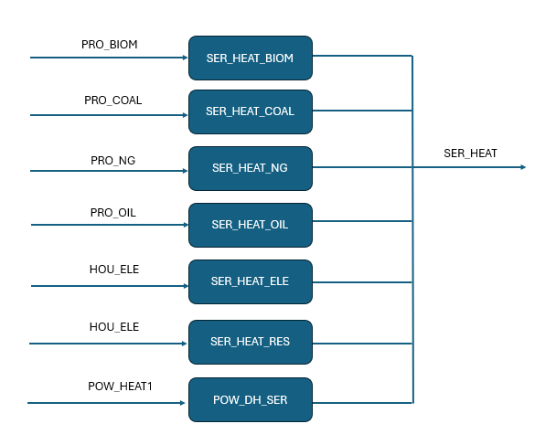
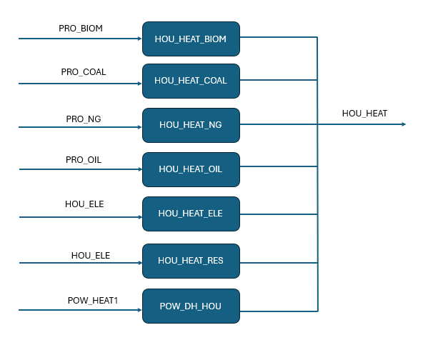
11.3 Modelling of residential and commercial-public services sector using OSeMOSYS
11.3.5 Different Heating Technologies
Notes:
In this slide we want to emphasise the many different fuel switching heating option technologies there could be in the model for the buildings sector. There can be many different types of boilers: BIOM = Biomass
COAL = Coal
NG = Natural gas
OIL = Oil ELE = Heat pumps RES = Resistive heaters
DH = District heating This shows how detailed heating can be and how technologies are modelled explicitly if they provide a fuel switching option.

Slide 18
Lecture 11.3 References
Plazas-Niño, F. A., Ortiz-Pimiento, N. R., & Quirós-Tortós, J. (2023). Supporting energy system modelling in developing countries: Techno-economic energy dataset for open modelling of decarbonization pathways in Colombia. Data in Brief, 48, 109268. https://doi.org/https://doi.org/10.1016/j.dib.2023.109268
18

Slide 19
11.4 Estimating modelling data
11.4.1 Final energy demands
Example 1: We have the useful energy balance and know the losses in consumption
Biomass – 100 PJ
Cookind demand – 8 PJ
Losses: 92%
Example 2: We have the final energy balance and know the technology efficiency
Biomass – 48 PJ
Cookind demand – 2.4 PJ
Standard efficiency: 5%
19
Notes:
As we studied earlier, energy balances are fundamental for energy system modelling. However, these balances do not provide insights into losses occurring in the final stage of energy consumption within end-use technologies. To address this gap, we can use useful energy balances, which are developed for each sector by analyzing the technologies in use and accounting for energy losses during consumption. These losses help calculate the useful energy demands and can also be used to estimate technology efficiencies.
For example, if 100 PJ of biomass is used for cooking and the final useful energy is 8 PJ, it indicates a 92% loss and an average efficiency of 8% for biomass stoves.
In cases where useful energy balances are unavailable, and data is missing, a workaround is to use standard efficiencies from literature or industry benchmarks. For instance, if 48 PJ of biomass is used for cooking and the average efficiency of biomass stoves is estimated at 5%, the energy demand for cooking would be 2.4 PJ.
These examples are applicable to any other energy demand in the residential or commercial and public services sectors.

Slide 20
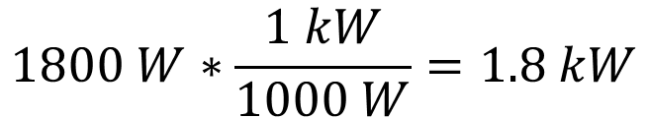
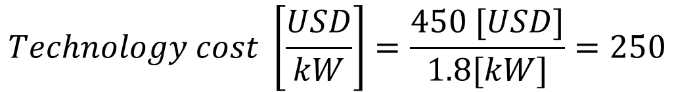
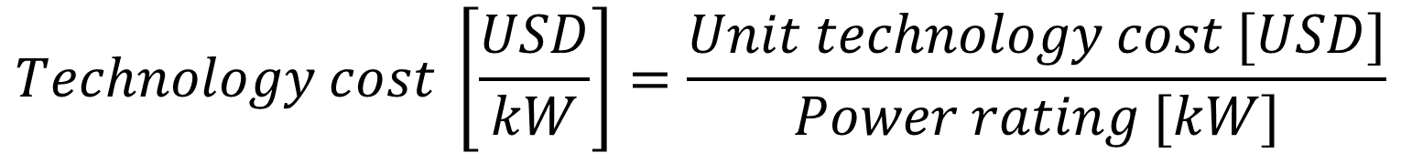
11.4 Estimating modelling data
11.4.2 Capital cost
The capital cost can be estimated using data on unit commercial prices and power ratings.
$$Technology cost \left[\frac{USD}{kW}\right]=\frac{Unit technology cost [USD]}{Power rating [kW]}$$
Example: An air conditioner costs 450 USD and has a power rating of 1800 W. What is the cost in USD per kW?
$$1800 W∗\frac{1 kW}{1000 W}=1.8 kW$$
$$Technology cost \left[\frac{USD}{kW}\right]=\frac{450 [USD]}{1.8[kW]}=250$$
20
Notes:
For common appliances such as refrigerators, air conditioners, and light bulbs, the capital cost represents the unit commercial price available in the market. These values vary based on the region, manufacturer, and size. Since modeling at such a detailed level often adds limited value, we can work with average values from well-known brands for different appliances.
The slide presents a basic formula to calculate capital cost using available data on commercial prices per unit and the capacity of the device. When multiple data points on prices and capacities are available, an arithmetic average can be performed to determine a representative value for the model.
In the example provided, the case of an air conditioner involves some preliminary unit conversions to complete the calculation. This type of analysis and data collection is part of the data processing stage.

Slide 21
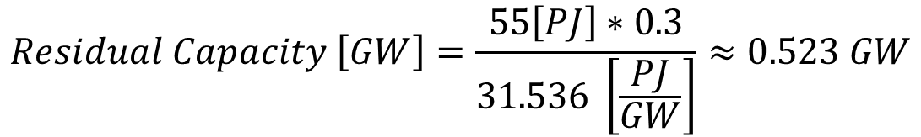
11.4 Estimating modelling data
11.4.3 Residual capacity
The residual capacity can be estimated using data of the final energy balance and technology efficiency.
$$Residual Capacity \left[GW\right]=\frac{Energy consumed by technology \left[PJ\right]∗Technology efficiency}{31.536 \left[\frac{PJ}{GW}\right]}$$
Example: Energy consumed by refrigerators is estimated at 55 PJ. If we consider a refrigerator efficiency equal to 30%, what is the approximate residual capacity?
$$Residual Capacity \left[GW\right]=\frac{55\left[PJ\right]∗0.3}{31.536 \left[\frac{PJ}{GW}\right]}≈0.523 GW$$
21
Notes:
Residual capacity represents the installed capacity of a technology, as studied with power plants. However, in the case of residential or commercial-public services sectors, this definition is less intuitive. To clarify, consider the example of refrigerators. In a region with 2,000 refrigerators averaging 200 W each, we can calculate the aggregated capacity as 400,000 W, or 400 kW. For OSeMOSYS, this 400 kW can be used as the residual capacity.
When accurate regional data on technological inventories is available, these capacities can be estimated directly. However, such data is often difficult to obtain. An alternative approach is to use information from the final energy balance and the efficiency of the specific technology to estimate residual capacity, as illustrated in the example. Residual capacity depends on the energy produced, which is why it must be multiplied by the technology's efficiency.
Typically, we assume a capacity factor of 1 for end-use technologies, as they are generally considered fully available at all times. If the capacity factor is different from 1, the equation should include a division by the capacity factor to account for this adjustment.

Slide 22
Lecture 11.4 References
Plazas-Niño, F. A., Ortiz-Pimiento, N. R., & Quirós-Tortós, J. (2023). Supporting energy system modelling in developing countries: Techno-economic energy dataset for open modelling of decarbonization pathways in Colombia. Data in Brief, 48, 109268. https://doi.org/https://doi.org/10.1016/j.dib.2023.109268
22

Slide 23
Thank you
Consolidated by:
Fernando Plazas-Niño, Fynn Kiley
www.climatecompatiblegrowth.com

